Slide 1
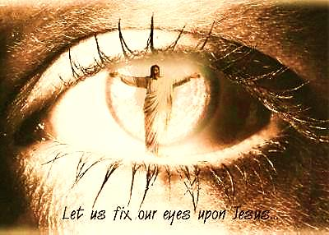
Seeing Jesus Pt. 2 - CHANGE

Slide 2
Note: After you download the slideshow, you may also need to download some videos from YouTube & add them into this PowerPoint. This tool can help you: Free YouTube Download
We present these messages in outdoor venues using the SonShineTent. Watch the video of our service that goes with this message, click here: http://campaignkerusso.org/?p=5210
We would love to know more about the people who download our lessons & sermons. We invite you to email us & let us know where & how you use them.
info@campaignkerusso.org

Slide 3
Welcome All

Slide 4
Let’s Begin with Prayer

Slide 5
Seeing Jesus Pt. 2 - CHANGE

Slide 6
Song: Open the Eyes of My Heart
Video Goes Here Title: Open the Eyes of My Heart Download Here:
http://www.youtube.com/watch?v=O1Fz1rviXFU

Slide 7
Hearing Jesus creates FAITH.
We begin to recognize and trust our Master’s directions.
SEEING Jesus gives COMFORT.
We begin to see His hand in our circumstances.

Slide 8
“They were to look for God. Then they might feel after Him and find Him because He is not far from each one of us.” Acts 17:27

Slide 9
Lies & Deception
Willfully Ignorant
Love Our Sin

Slide 10
Song: Jesus is Standing Right in Front of You
Video Goes Here Title: Jesus is Standing
Right in Front of You Download Here:
http://www.youtube.com/watch?v=QldzrQbRqP4

Slide 11
Video: Jesus Heals Blind Man
Video Goes Here Title: Jesus Heals Blind Man
Download Here:
https://youtu.be/5UQlU29a9eE

Slide 12
Video: We see Jesus, We Change

Slide 13
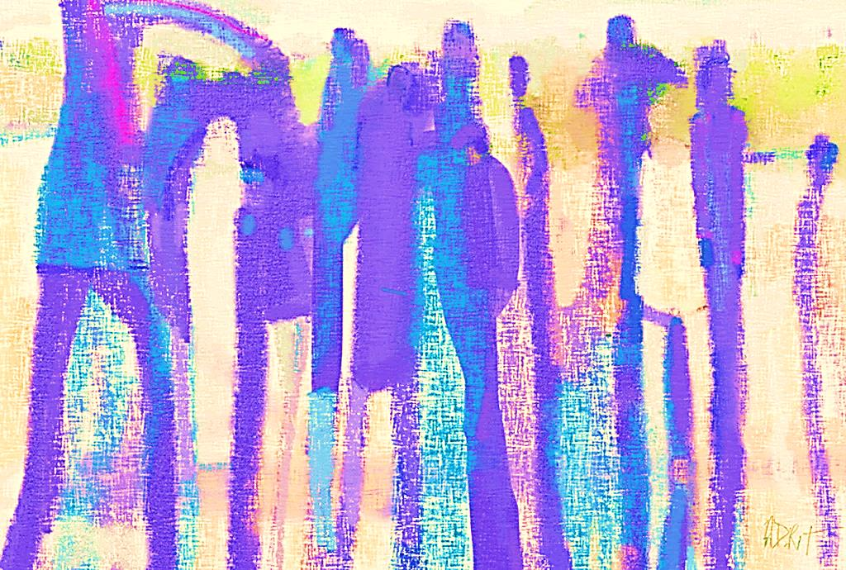
Spiritual Sight Increases With Use
“…He spit on the eyes of the blind man and put His hands on him. He asked, “Do you see anything?” The blind man looked up and said, “I see some men. They look like trees, walking.”
Jesus put His hands on the man’s eyes again and told him to look up. Then he was healed and saw everything well.” Mark 8:23-25

Slide 14
Spiritual sight increases with use.
Jesus gives us sight, and increases that sight as we continue with Him.
Let Him touch you again and again.

Slide 15
Then I will have complete knowledge as God has complete knowledge of me.” 1 Cor. 13:12
“Now we see a blurred image in a mirror. Then we will see very clearly. Now my knowledge is incomplete.

Slide 16
Our spiritual sight improves as we continue looking at Jesus.
In His word,
In worship
In our life
In someone else’s life
In blessings & troubles
At His coming
At His throne

Slide 17
Seeing Jesus Changes Us
Seeing Him changes us into His image. The more we look, the more we change.
“We are already God’s children, and we can’t even imagine what it is going to be like later on.
But we do know this, that when he comes we will be like him, as a result of seeing him as he really is.”
1 John 3:2-3

Slide 18
The more we look AT Jesus, the more we look LIKE Jesus.
“All of us…show the shining-greatness of the Lord as in a mirror. All the time we are being changed to look like Him…” 2 Cor. 3:18

Slide 19
Seeing Jesus more and more as we grow in Christ:
First we are groping in darkness.
Then we hear the Savior calling and feel Him drawing us to Himself.
We face the greatest choice in life.
We cry out to Jesus—our turning point.
Our eyes are opened—we rejoice.
We see dimly at first.
We continue with Jesus.
We finally see Him fully—face to face.

Slide 20
Song: I Bowed On My Knees
Video Goes Here Title: I Bowed On My Knees
Download Here:
http://www.youtube.com/watch?v=XNmIfGGQ94s

Slide 21
Is Jesus
Speaking to You?
“They said to each other, ‘Did not our hearts burn within us while he talked to us on the road, while he opened to us the Scriptures?’”
John Wesley Said:
“…the preacher was describing the change which God works in the heart through faith in Christ and I felt my heart strangely warmed.”
Jesus makes His presence Known by a small voice!

Slide 23
What is the Sinner‘s Prayer?
This is a prayer we can pray when we are ready to admit we are sinners and need Christ’s forgiveness.
It must be prayed with faith in our hearts and a readiness to have a life-changing encounter with Jesus Christ.

Slide 24
A prayer of faith → Pray this prayer if :
If you never have before
You have in the past, but you think it would mean more today
You have been walking afar off and you want to come back
You want to set an example & show others how it is done
You just like to give your heart to Jesus again & again
Faith

Slide 25
We Declare Our Faith Publicly Because Jesus Declared His LOVE Publicly
“If you stand before others and are willing to say you believe in me, then I will tell my Father in heaven that you belong to me.” Mat 10:32

Slide 26
Three Important Questions
Do you want to know Jesus as your Savior right now?
Do you believe He died to save you from your sins & that He rose from the dead?
Do you believe that He is here, waiting to save you right now?

Slide 27
The Prayer of a Sinner Turning to Jesus
Dear Jesus, I know that I have sinned against You and that my sins separate me from You.
I am truly sorry.
Right now, I turn away from my sinful past .
Please forgive me, and help me to keep from sin.
I believe You died for my sins.
I Believe You rose from the dead, you are alive, and you hear this prayer from my heart.
I invite You Jesus to be both my Savior and the Lord of my life.
I want You to rule my life from now on.

Slide 28
“But some people did accept him. They believed in him, and he gave them the right to become children of God.”
John 1:12

Slide 30
“If you openly say, ‘Jesus is Lord’ and believe in your heart that God raised him from death, you will be saved.”
Rom. 10:9
What did you learn today?
What about seeing Jesus?
What have you been thinking about God lately?
What do you want to tell others about Jesus?

Slide 31
Let’s Close in Prayer

Slide 32
Note: After you download the slideshow, you may also need to download some videos from YouTube & add them into this PowerPoint. This tool can help you: Free YouTube Download
We present these messages in outdoor venues using the SonShineTent. Watch the video of our service that goes with this message, click here: http://campaignkerusso.org/?p=5210
We would love to know more about the people who download our lessons & sermons. We invite you to email us & let us know where & how you use them.
info@campaignkerusso.org

